Slide 1
Growth and Reproduction

Slide 2
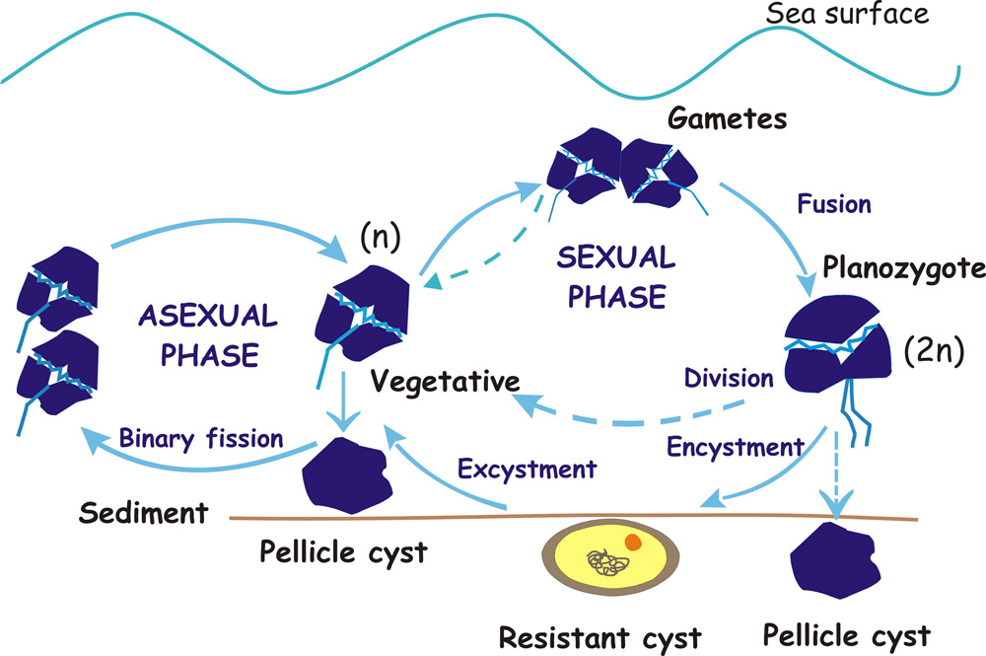

Slide 3
Dinoflagellate Cycle
Growth
Sexuality
quiescence (immobile)
“cyst”

